Slide 1
AI Institutional Knowledge Assistant A Retrieval-Augmented Generation (RAG) System for Enterprise Document Intelligence Tech Stack:- Streamlit MiniLM Embeddings FAISS CrossEncoder Gemini 2.5 Flash SQLite
Subhash P

Slide 2
Problem Statement:
Business Problem
Organizations store critical information inside PDFs.
Challenges:
🔴 Manual searching is time-consuming
🔴 Information is scattered across documents
🔴 Employees struggle to locate answers quickly
🔴 Traditional search lacks semantic understanding
🔴 No visibility into AI answer quality

Slide 3
Goal: Build an AI assistant capable of answering document-based questions with grounded and explainable responses.

Slide 4
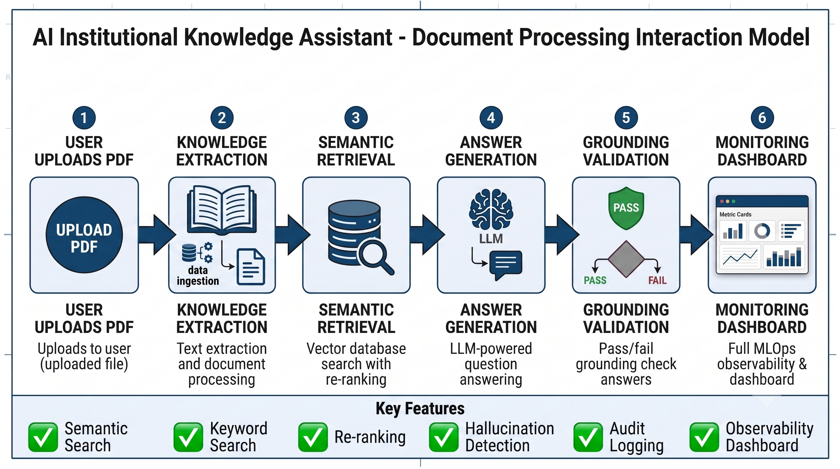
Solution Overview

Slide 5
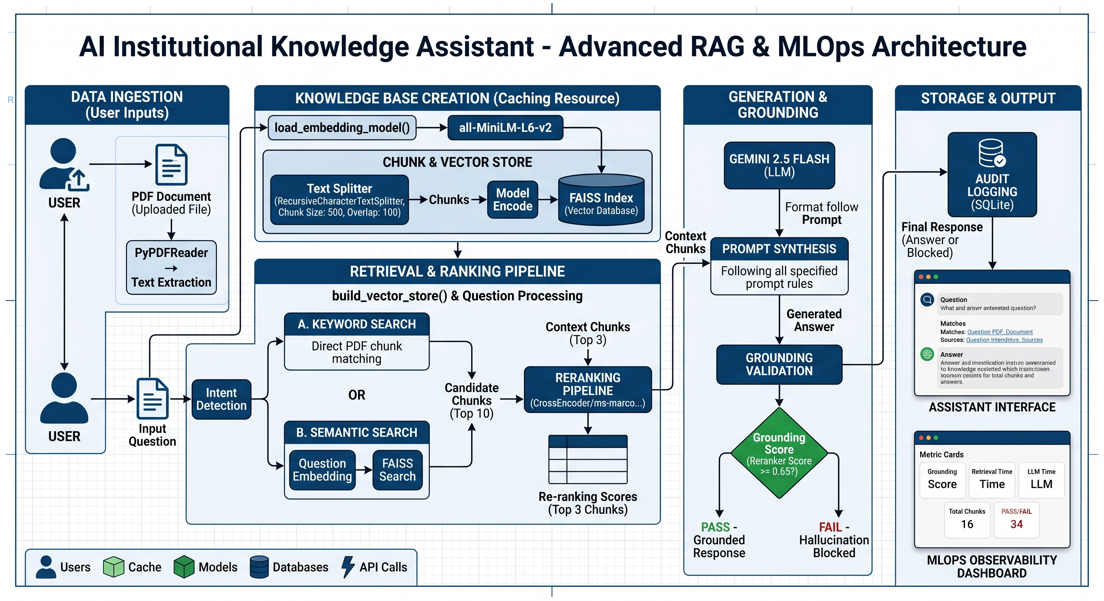
System Architecture:

Slide 6
Technical Design Decisions:
Component | Why Chosen
MiniLM | Lightweight and fast embeddings
FAISS | Efficient semantic retrieval
CrossEncoder | Improves relevance ranking
Gemini 2.5 Flash | Fast response generation
SQLite | Lightweight audit logging
Streamlit | Rapid AI application development

Slide 7

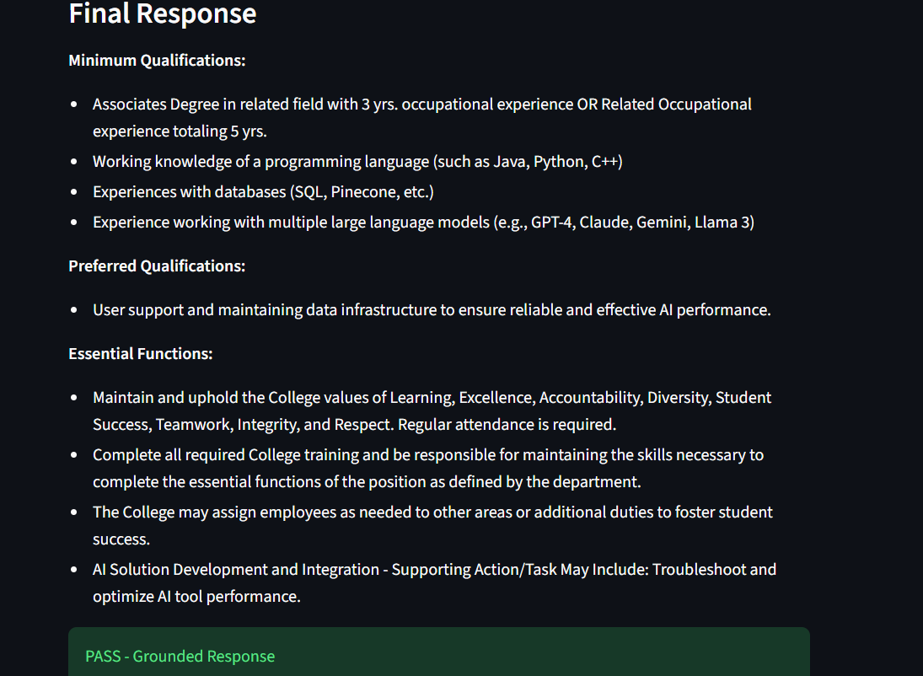
Observability Dashboard

Slide 8
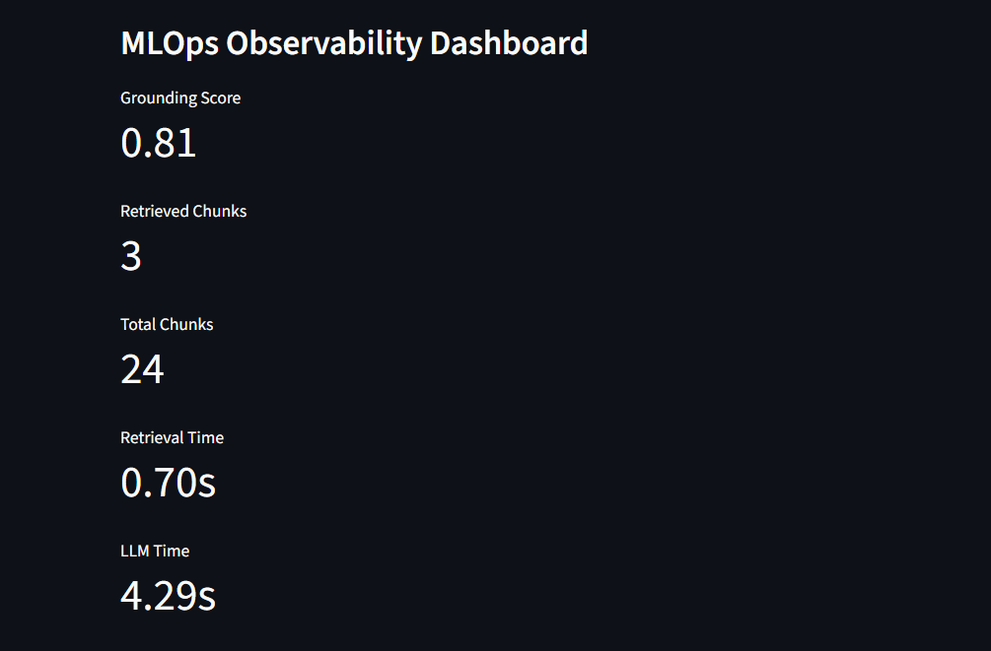


Slide 9
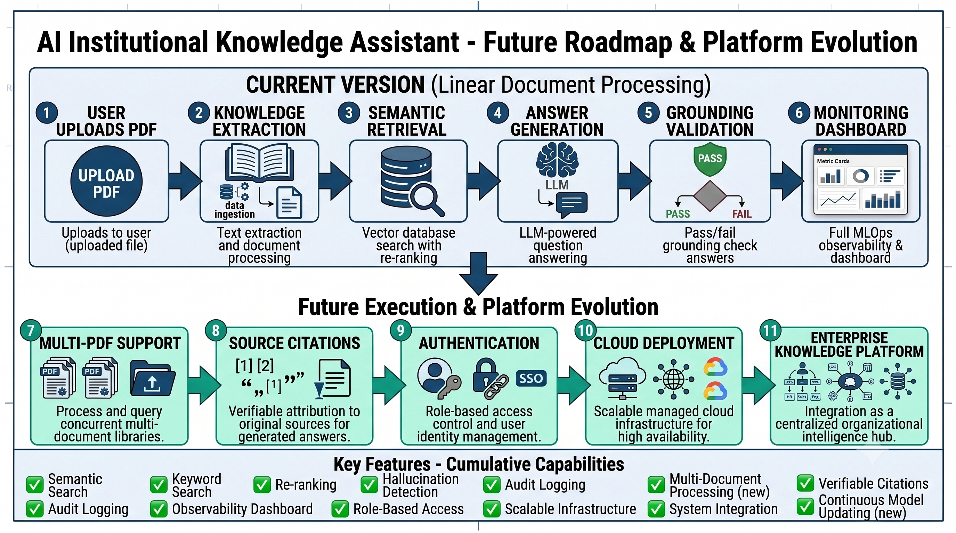
Future Roadmap:

Slide 10
References, Tools & Acknowledgments
Technical References
FAISS Documentation
Sentence Transformers Documentation
Google Gemini API Documentation
Streamlit Documentation
PyPDF Documentation
Models & Frameworks Used
Gemini 2.5 Flash (LLM)
all-MiniLM-L6-v2 (Embeddings)
CrossEncoder ms-marco-MiniLM-L-6-v2 (Re-ranking)
FAISS (Vector Search)
SQLite (Audit Logging)
Streamlit (Application Layer)
AI-Assisted Development
Architecture diagrams and visual assets were generated and refined using Google Gemini. Presentation structure, design brainstorming, technical review, and communication refinement were assisted using OpenAI ChatGPT.

Slide 11
Thank You

